Slide 1
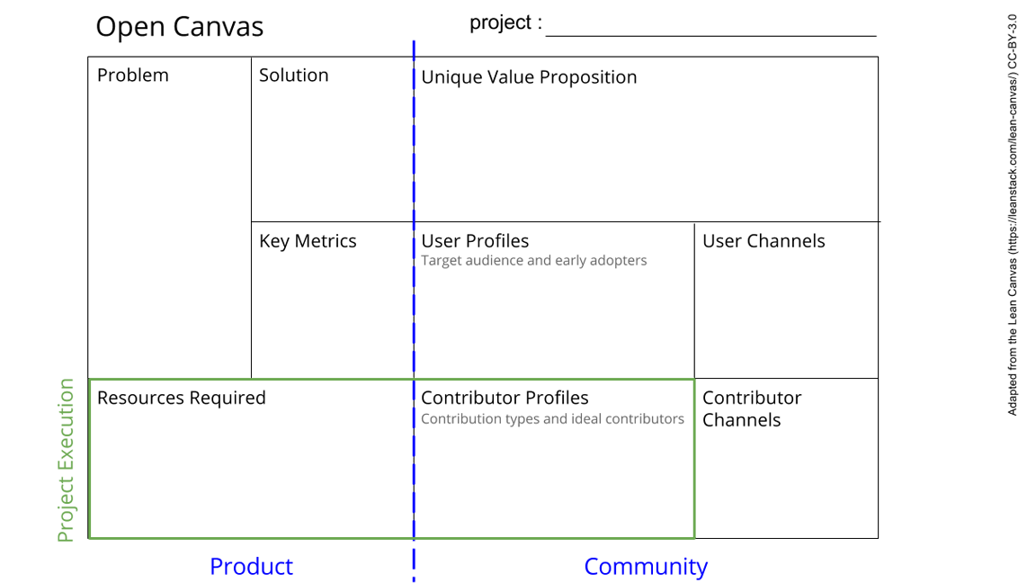
LoRa Data Loggers
We offer accurate, reliable, continuous and open information about the environmental state of freshwater and air.
1. It will be solve the lack of attention and credibility of environmental problems.
2. People will have more data to claim about their rights. Scientists more data to make papers. State to more data to show their remediation policies
*Suquía River environmental degradation
*Produce a device for measurements of water quality, open, cheap, customisable, replicable, that can be able to send constant and wireless information.
*Give tools to the society to afford the problematic of environmental pollution
*Make a real time source of environmental data
*LoRa Data Loggers
*An Open data base with environmental information
*Scientific institutions interested
*Scientists interested
*High schools interested
*Open database traffic
*Tutorials
*Web site
*Environmental Scientists
*High schools
*Scientific Institutions
*3D printer
*microcontrolers
*sensors
*trained people
*Geeks
*Hobbists
*Environmental activists
*Educators
*Slides
*Surveys
See next slide for instructions!
Notes:
Go to File > Make a Copy… to make your own canvas
See next slide for instructions

Slide 2
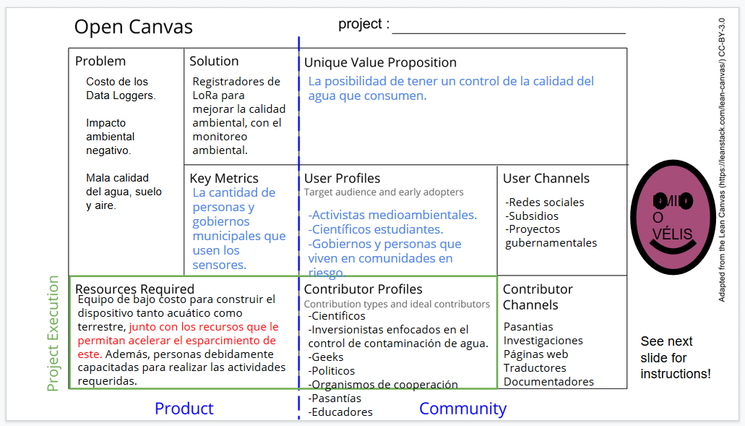

Slide 3
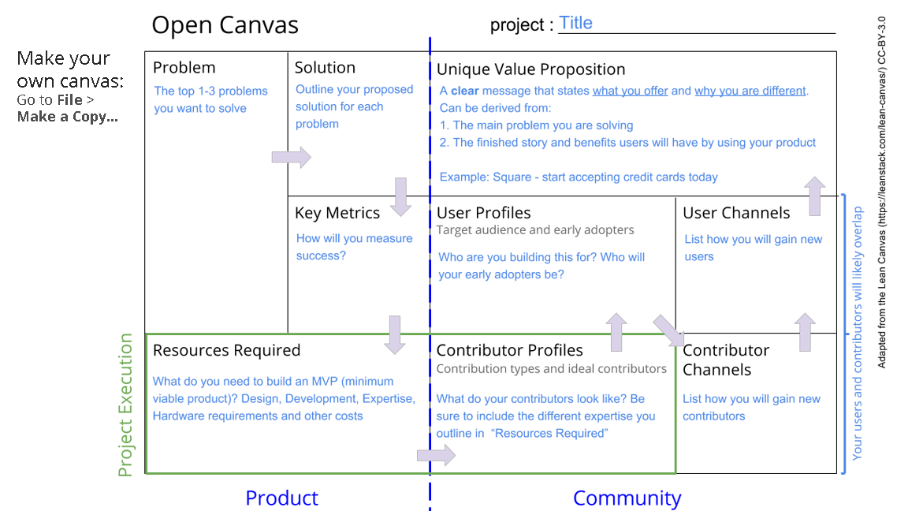

Slide 4
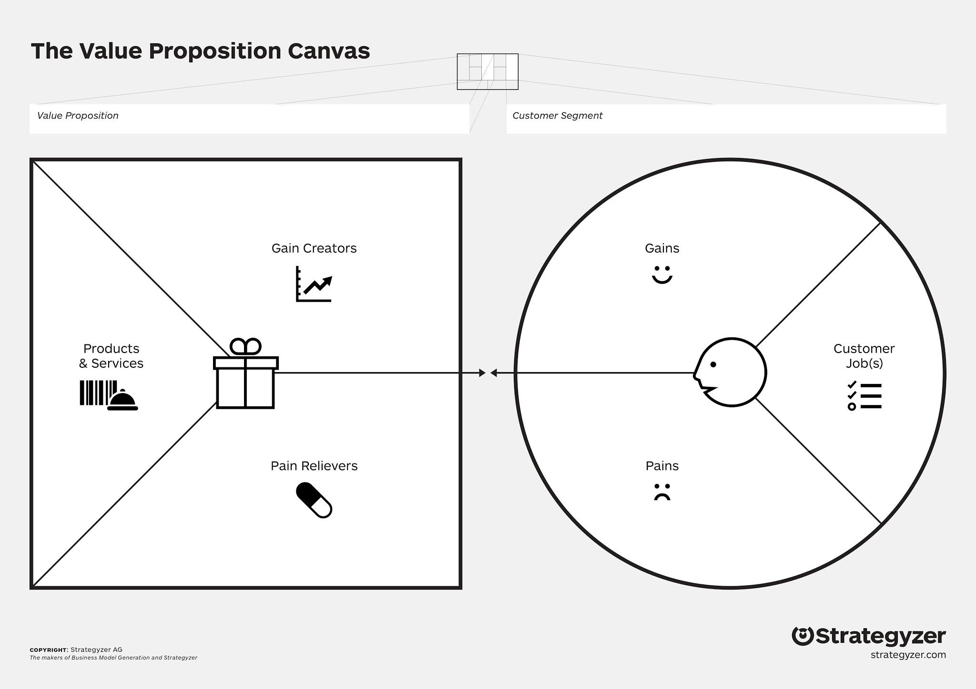


Data logger for environmental variables
Scientists
Take data at real time
Help people affected by environmental degradation
More papers
Cost effective data acquisition
Repairable hardware
Scientific dissemination
Take accurate and reliable data
Publish papers
Reports
Data logger
Cheap
Replicable
Customisable
Open access
Wireless
Cheap
Open
Reduced maintenance costs
Lower monitoring costs
Expensive sensors
Travel cost to take data
Known state of sensors

Slide 5


Data logger for environmental variables
State
Possibility of locating offenders
Keep people informed
updated information
Prevent sanitary problems
Identify deteriorated zones
Guarantee a healty environment
know the state of the basins
Data logger
Cheap
Replicable
Customisable
Open access
Wireless
Cheap
Open
Reduced maintenance costs
Prevent infectious foci
Expensive sensors
Travel cost to take data
Known state of sensors

Slide 6
Data logger for environmental variables
State
Possibility of locating offenders
Keep people informed
updated information
Prevent sanitary problems
Identify deteriorated zones
Guarantee a healty environment
know the state of the basins
Data logger
Cheap
Replicable
Customisable
Open access
Wireless
Cheap
Open
Reduced maintenance costs
Prevent infectious foci
Expensive sensors
Travel cost to take data
Known state of sensors

Slide 7

Data logger for environmental variables
Schools
Possibility of locating offenders
Keep people informed
External groups collaboration
New laboratory materials
Give service to society
Give contents to students
Generate socio-environmental awareness
Provide tools for future jobs
Data logger
Cheap
Replicable
Customisable
Open access
Wireless
Linked to a friendly graphic interface
Students could become in social relevant actors
make teachers' work more bearable
Student’s lack of motivation
Integrate curriculum content
Get materials for practical activities

Slide 8
Data logger for environmental variables
Contributor
Teacher
Possibility of locating offenders
Keep people informed
Get students to pass their exams
Awaken the interest of the students
Get more teaching material
Give contents to students
Get students to finish their course
Integrate curriculum content
Data logger
Cheap
Replicable
Customisable
Open access
Wireless
Linked to a friendly graphic interface
Students could become in social relevant actors
make teachers' work more bearable
Failed students
Student dropout
Lack of integration with other subjects

Slide 9
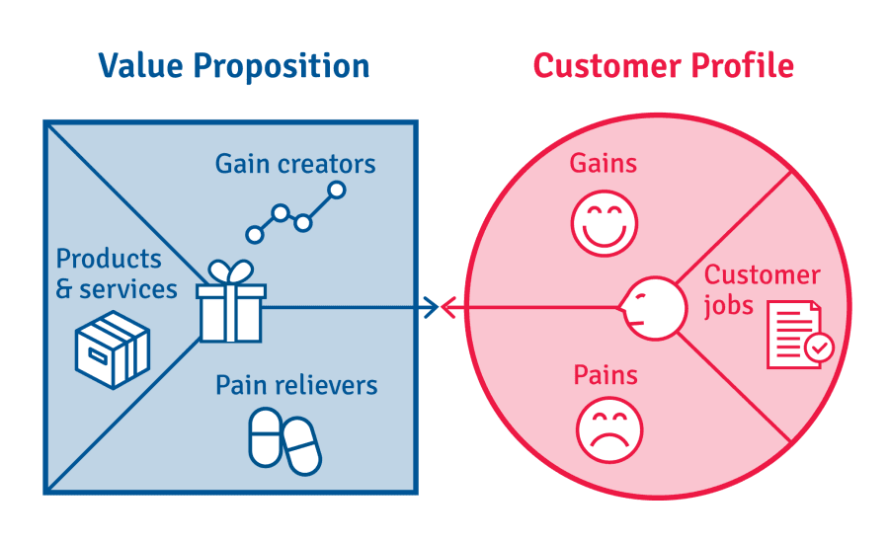
User/Contributor profile
Personas

Slide 10
Personas: José (Contributor)
José is advanced electrical engineering. He want to specialize in environmental sensors. He has no yet begin master graduation thesis
Jobs: Graduate from college. He wants to make an environmental sensor that can also be a engineering graduation. He needs to get his sensors calibrated by biologists.
Pains: He does not know how to connect with people from other disciplines. He cannot validate the measurements of his sensors himself.
Gains: He would like to find an applicability for his sensors. He would like to get experience in working in interdisciplinary work. He would like to learn the use of repositories and open project documentation

Slide 11
Personas: Natalia (User)
Natalia is a scientific researcher studying the effect of environmental degradation in invertebrates communities of Luján streams
Jobs: Design samplings to get representative samples of bentos to compare with different conditions zones in the stream. After that, produce high impact scientific articles.
Pains: She have some problems to relate the composition of assembles with the particular conditions of water at the time of samplings. She have also some economical limitations for samples recollection and equipment manteinance.
Gains: She would like to have more quality and quantity of environmental data. Have more novelty data. To give more social relevance to her studies.

Slide 12
Personas: Victoria (User)
Victoria is a Chacra La Merced neighbour. She and some of her friends lives near the Suquía River and they see it as a threath to public health. She and her friends want to do a report about the pollution and dangers related to the river and to be disseminated in the media
Jobs: Pass the course. Care the family’s livestock. Finish high school.
Pains: That some relative get sick by pollution. Do not pass the course. Do not find a job.
Gains: She wants to know safe zones to walk. That state make remediation actions. Finish high school.

Slide 13

Pathways

Slide 14
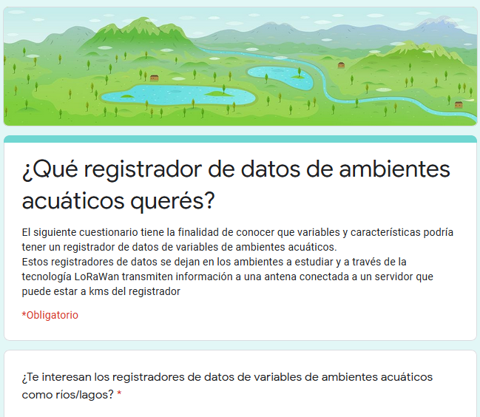
Electronic surveys
High schools, city councils, Scientists
To know what are the needs of potential users

Slide 15
Readme.MD
For users and contributors

Slide 16
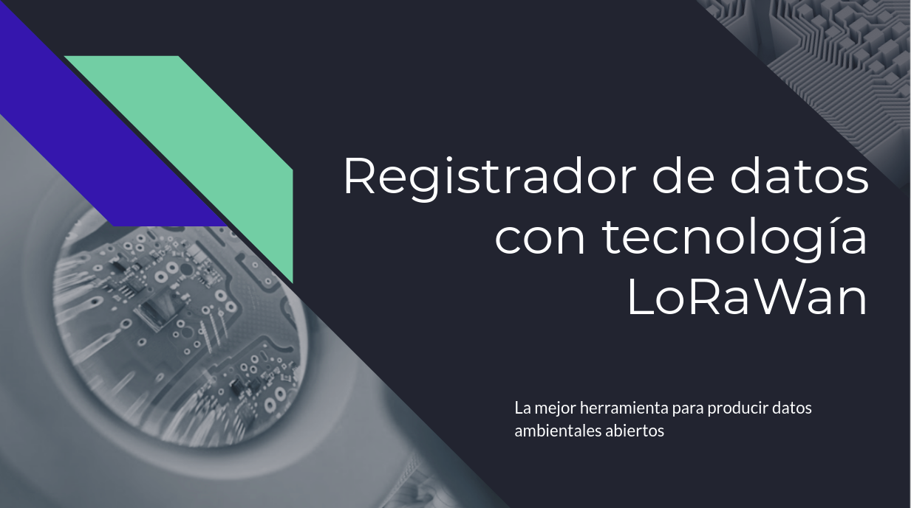
Slides for presenting to contributors

Slide 17
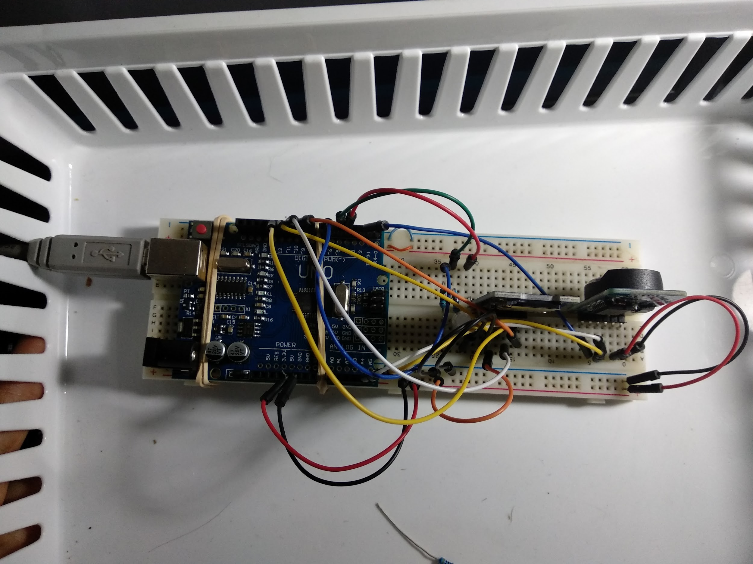

Slide 18
Tests

Slide 19
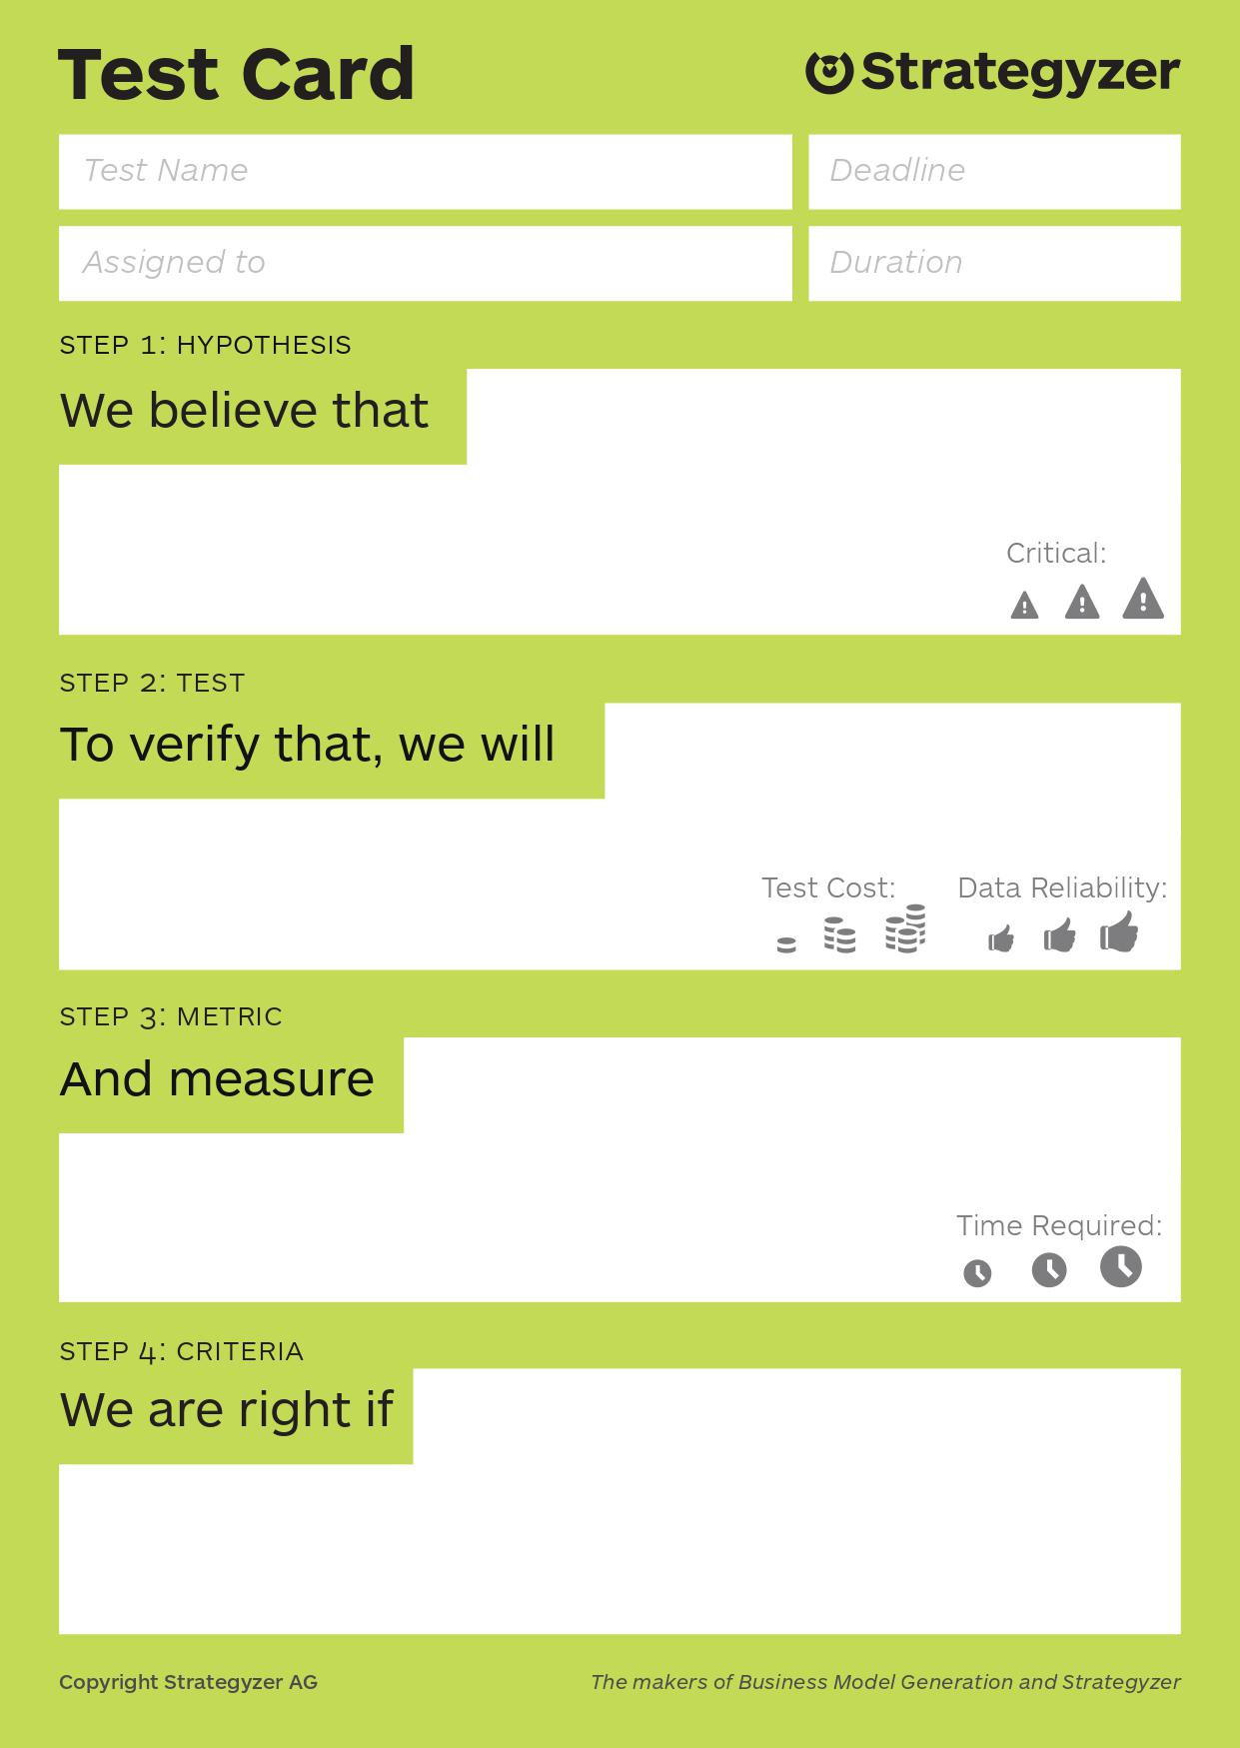
Open data base
Users are interested in put the data logger collected information in an Open data base
gonna do a survey
How many user agree to make your data open
Most users are ok with this idea

Slide 20
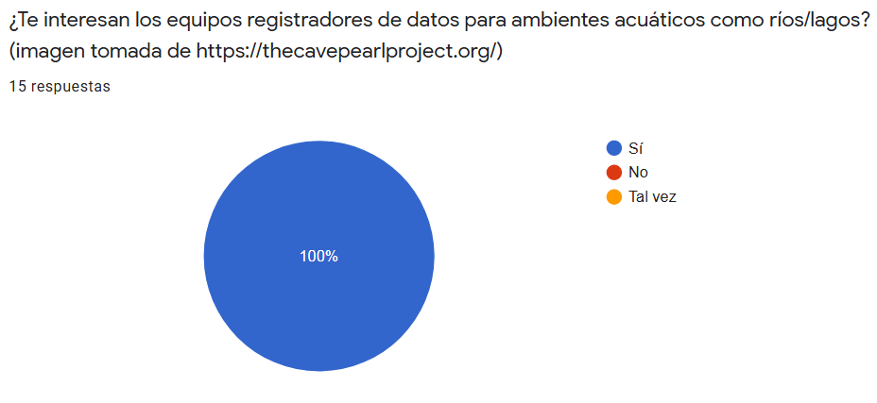

Slide 21
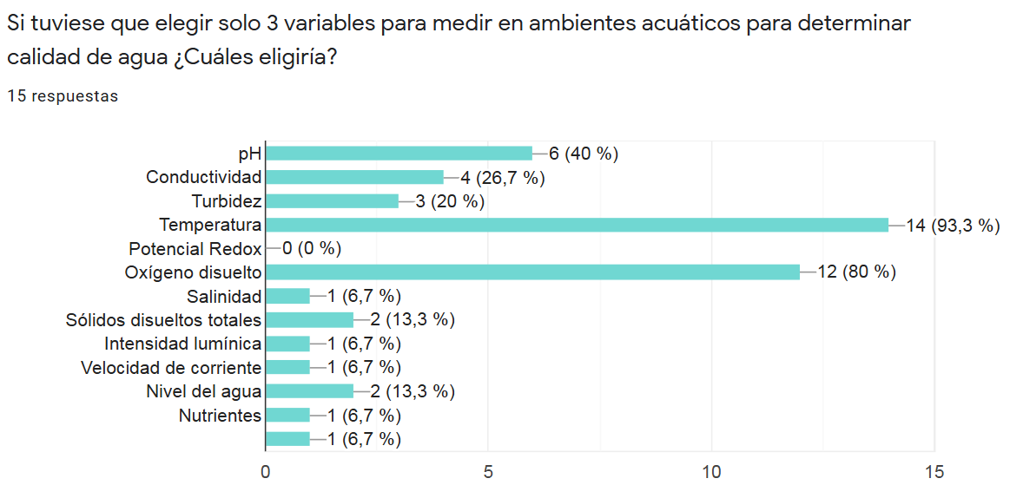

Slide 22
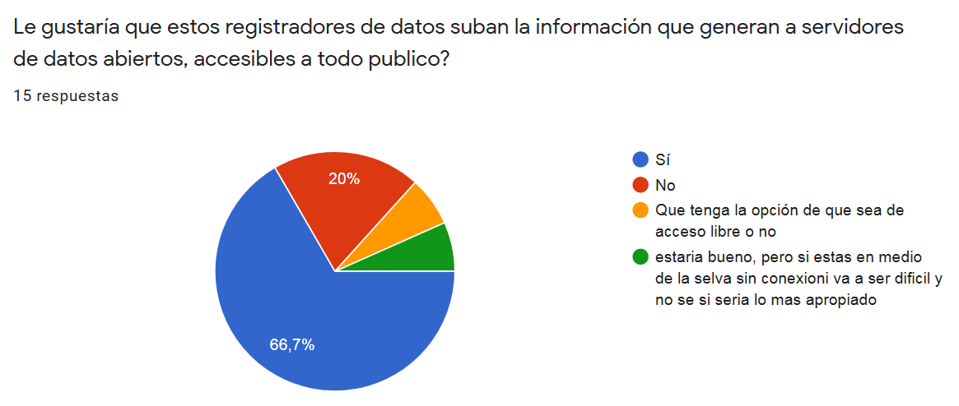

Slide 23
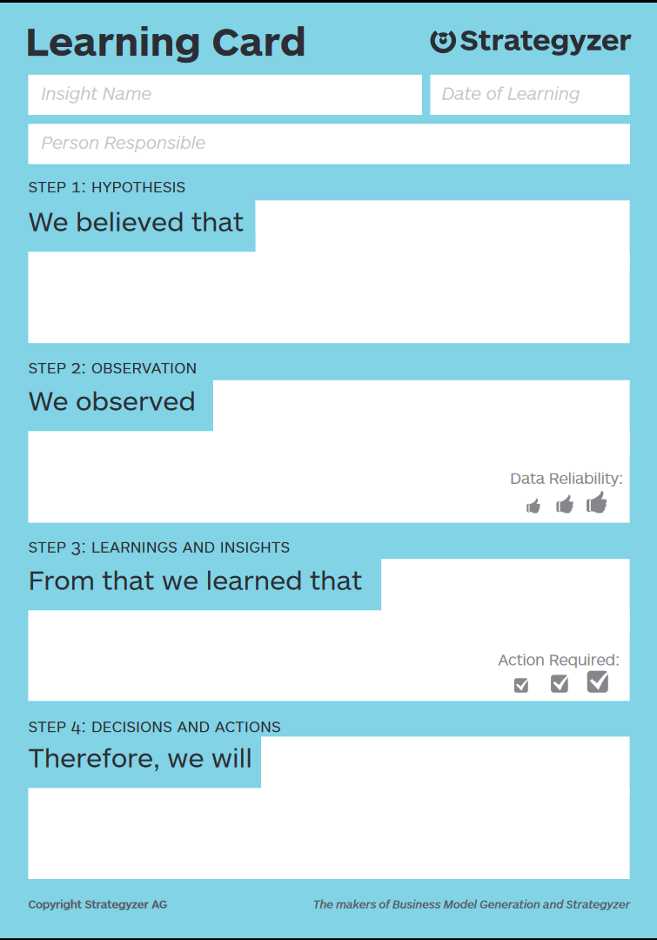

Slide 24
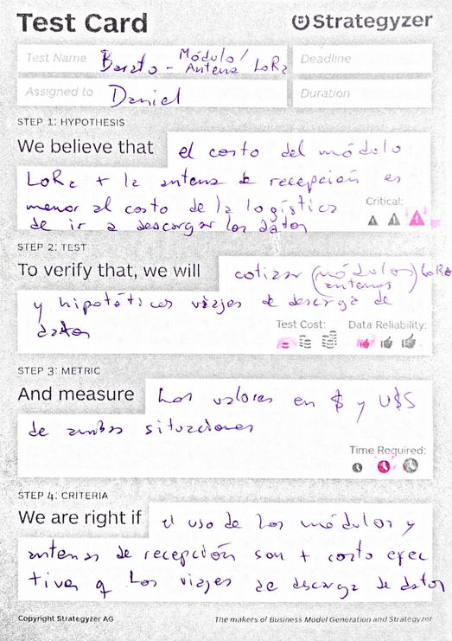
Cheap and open
Users are interested in put the data logger collected information in an Open data base
gonna do a survey
How many user agree to make your data open
Most users are ok with this idea

Slide 25
Open data base
Users are interested in put the data logger collected information in an Open data base
gonna do a survey
How many user agree to make your data open
Most users are ok with this idea

Slide 26
